Slide 1

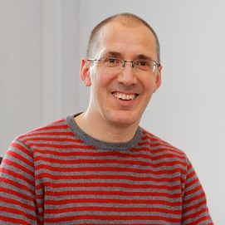
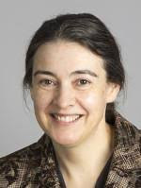
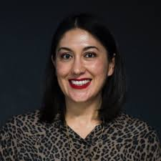
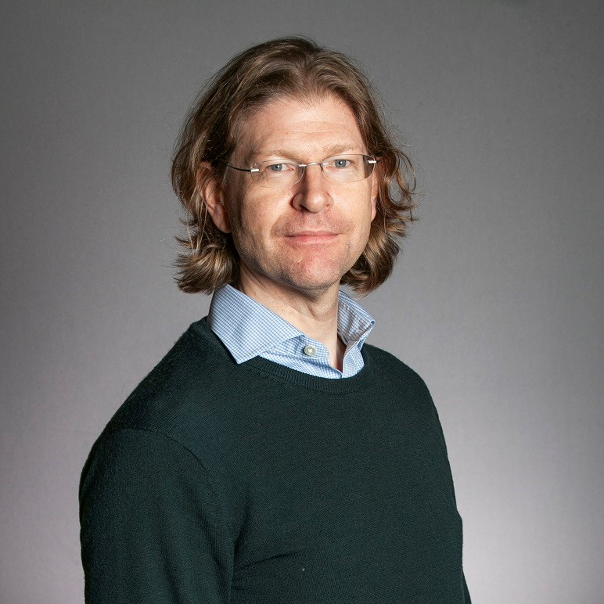
Lennard Jones Centre Gender Equality Network Panel Discussion
The Diversity Challenge in the materials and molecular modelling community
Chair: Christoph Schran
Angelos
Michaelides
Clare
Grey
Rosana
Collepardo
Chris
Pickard
Notes:
Thank the speakers!
Fix rthe

Slide 2
Disclaimer
i) This series of slides was created to stimulate a discussion and part of a panel discussion, so some slides might be missing some context or contain errors.
(ii) The authors were Yair Litman (litmany@mpip-mainz.mpg.de) and Niamh O’Neill (nco24@cam.ac.uk). Feel free to reach out for further discussion or any questions. iii) We are very happy and indeed encourage these slides to be shared and built upon to promote further discussion!

Slide 3
Pre-discussion agreement
The aim is to have a constructive and positive discussion. Therefore the panellists agree to discuss openly and honestly.
The audience (you!) therefore understand that this is a discussion of ideas in real time, and necessarily answers will not be fully polished. We will therefore not hold the panellists to an unrealistic standard and instead aim to have a constructive discussion.
Remember, by attending, everybody is on the same page in wanting to improve the diversity issue in our community!
Notes:
We include real research – if you are interested in reading more the references should be on the slides, else just ask us afterwards

Slide 4

What colour do you see?
Notes:
Goal: I) have a bit of fun with the audience
ii) highlight how schemas/background can influence the objective facts.

Slide 5
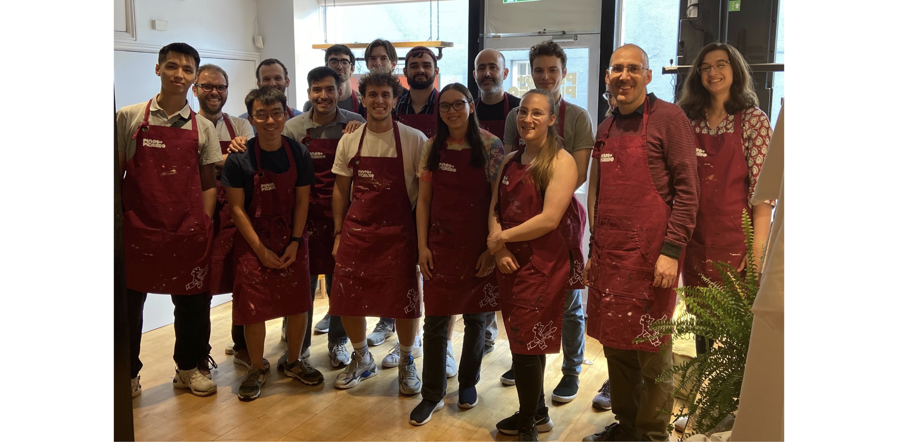
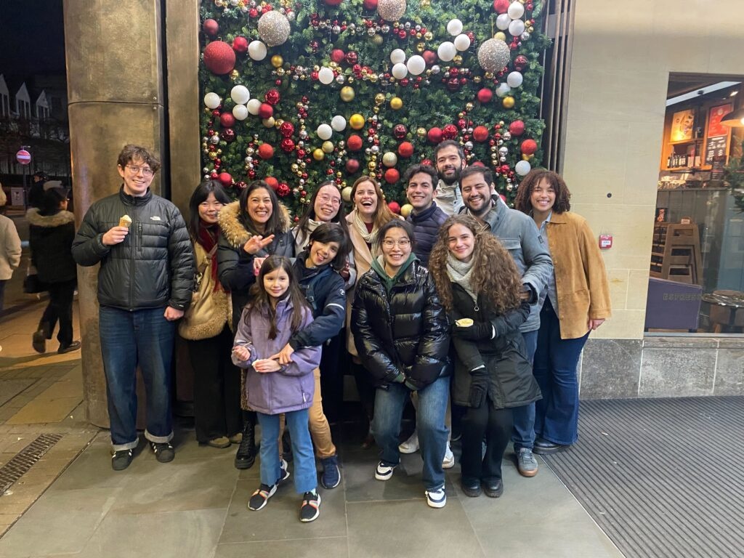
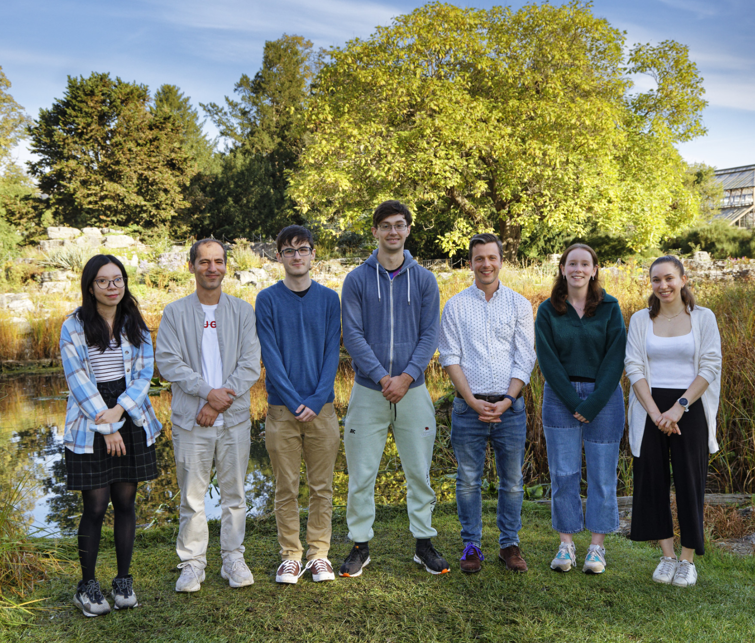

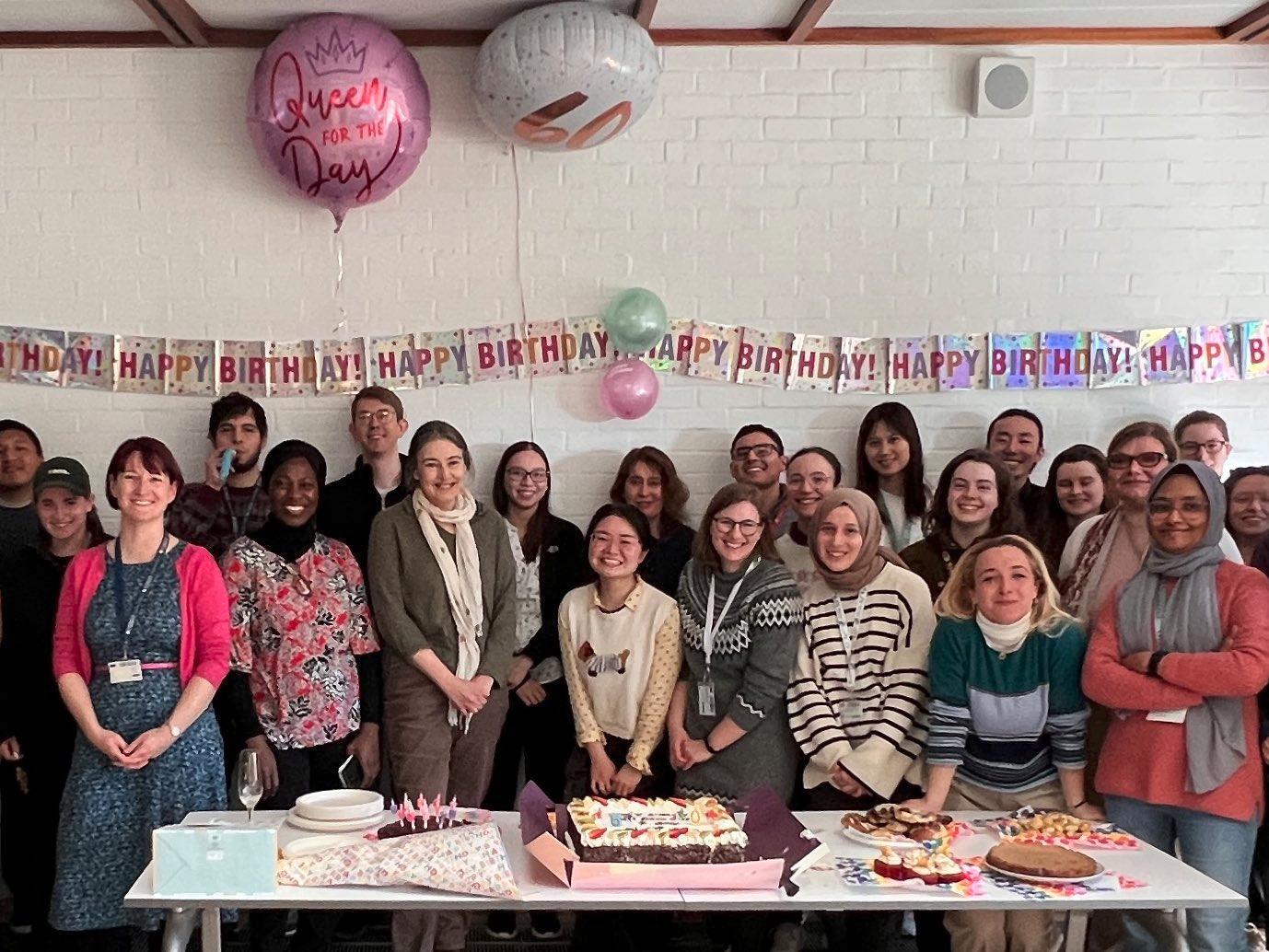
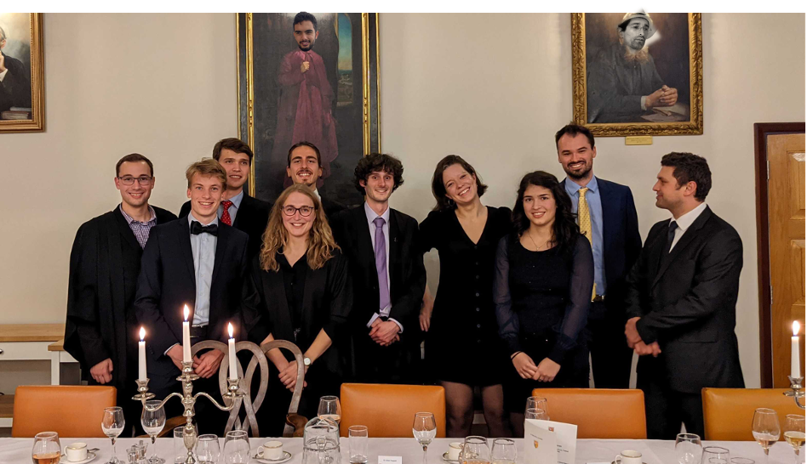
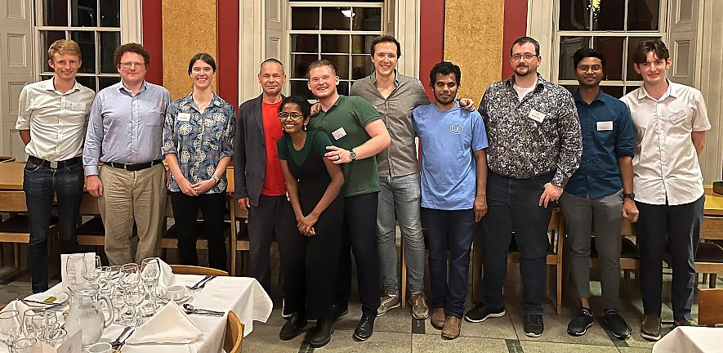
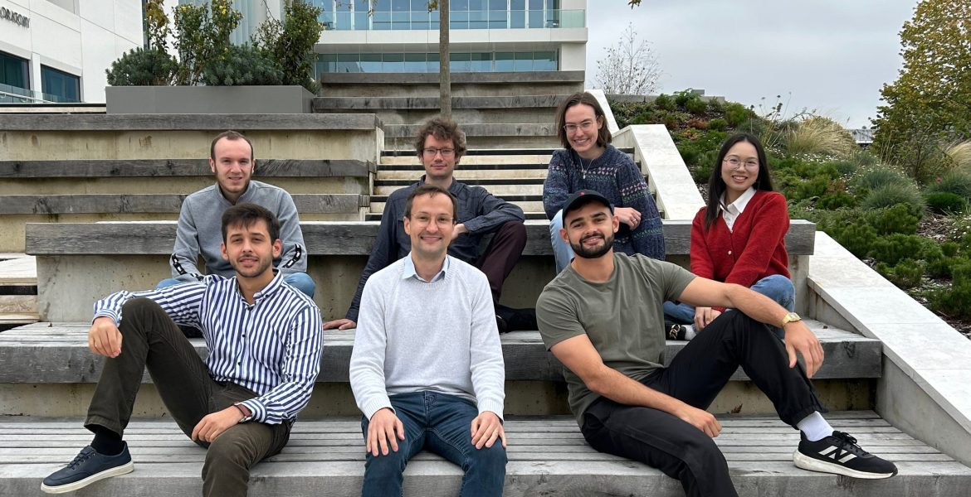
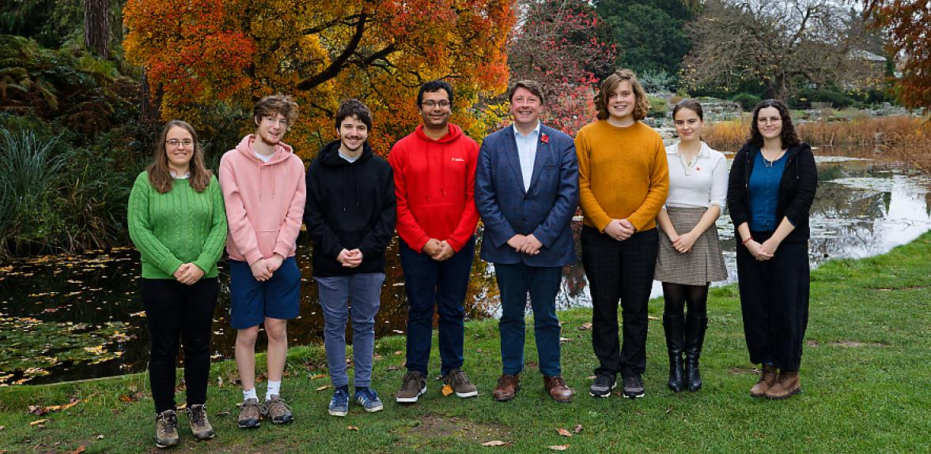
What does diversity mean to you?
Notes:
This is a very broad question to start. It can be how the panelists value diversity, what advantages they think it can bring, maybe if they have any personal examples the would like to share.

Slide 6

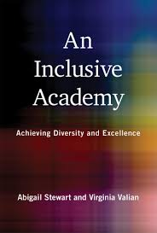
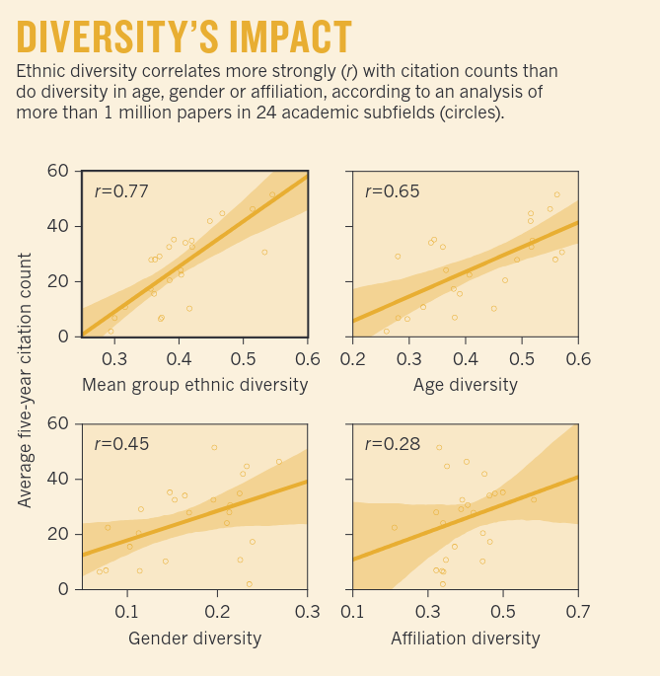
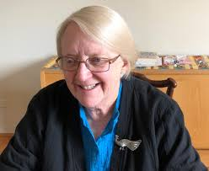
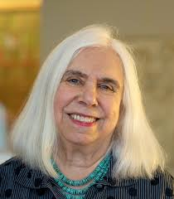
What does the research say?
Diversity vs Excellence Debate
Diversity increases innovation
Enlarges changes and improves areas of study
Explore the full pool of talent available to capitalize on
And …
Analysis of more than 1 million papers in 24 academic subfields in the United States, United Kingdom, Canada and Australia.
Powell, K. Nature 558, 19-22 (2018)
Notes:
Does diversity come at the cost of excellence?

Slide 7
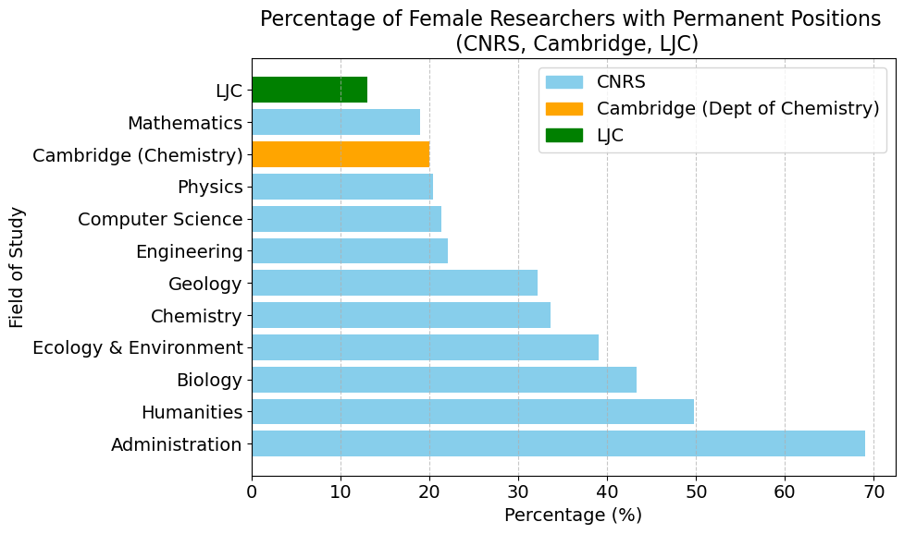
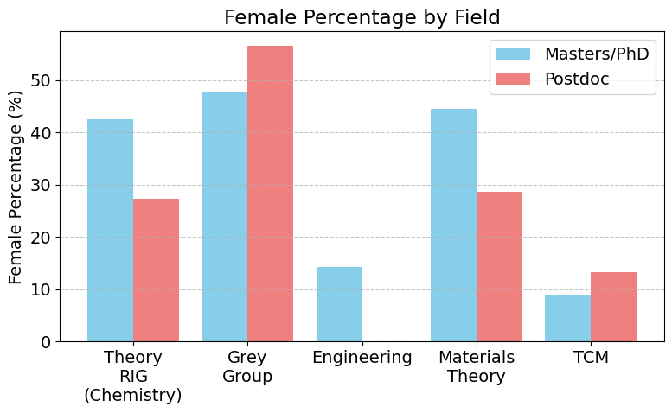
How well is the LJC doing? Let’s look at the numbers!
1) ‘Global scale’
2) ‘Local’: LJC
Thanks to Camile Scalliet for help with the CNRS data
Notes:
(possible) questions next slide, below points to make regarding the stats
First lets try get a handle of the more broad situation and see overall where we (LJC) fit in.
Then we can compare within the LJC what the situation is like.
Finally lets take some showcase examples from our panel members groups.

Slide 8
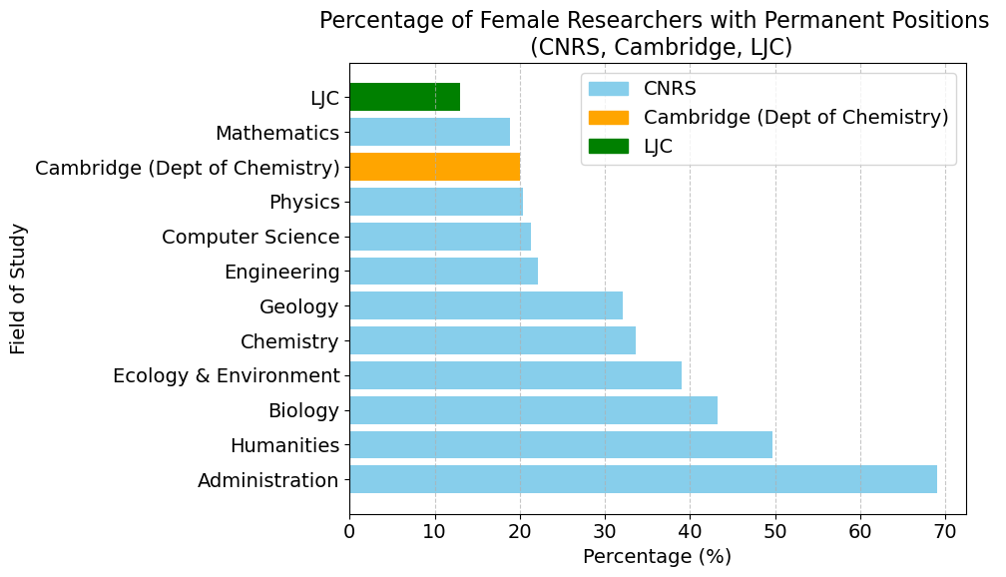
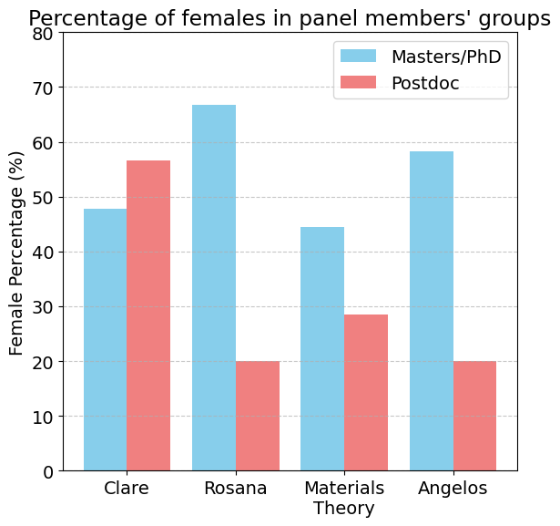
How well is the LJC doing? Let’s look at the numbers!
1) ‘Global scale’
3) In the room
2) ‘Local’: LJC
Notes:
Questions:
I) Why is the LJC doing so badly, in absolute terms and relative to i) chem department ii) (optional) CNRS? iii)
The panel members groups are overall doing a great job at PhD level especially, overall above the average for chemistry (which has the best ratio among disciplines).
Do the panelists think there is a particular reason why this is the case - what things do you think you are doing well and maybe others can learn from? iv) (optional)
How to now bridge the gap to the next level beyond PhD to postdoc and PI? I think this question links in with the subsequent questions and topics, so maybe we just leave this as an open question for now…
First lets try get a handle of the more broad situation and see overall where we fit in.
Then we can compare within the LJC what the situation is like.
Finally lets take some showcase examples from our panel members groups.

Slide 9
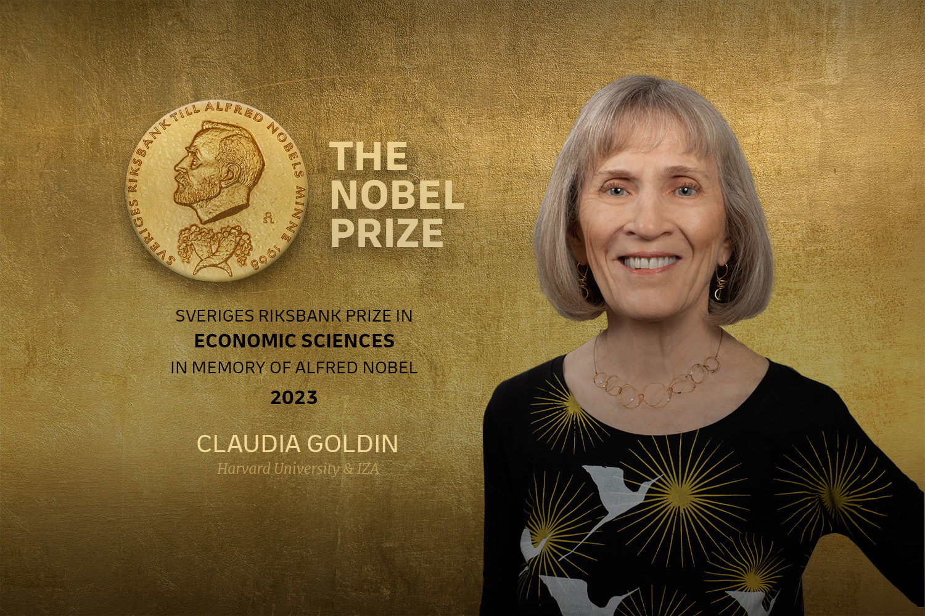
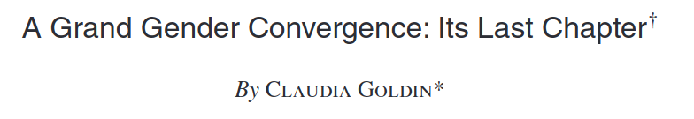
Is academia doomed to be unequal?
“ [Gender gap exists mainly] because hours of work in many occupations are worth more when given at particular moments and when the hours are more continuous. That is, in many occupations earnings have a nonlinear relationship with respect to hours.”
Linear jobs:
Teacher
Pharmacist
Non-linear jobs:
Lawyer
Finance
Academia?
Vs
American Economic Review Vol.104, No.4, April 2014 (pp. 1091-1119), (see also Freakonomics interview Online)
Notes:
Question: Is academia doomed to be unequal? According to Goldin: What, then, is the cause of the remaining pay gap? Quite simply the gap exists
because hours of work in many occupations are worth more when given at particular
moments and when the hours are more continuous. That is, in many occupations earnings have a nonlinear relationship with respect to hours. A flexible schedule
often comes at a high price, particularly in the corporate, financial, and legal worlds. A compensating differentials model explains wage differences by the costs of
flexibility. The framework developed here shows why there are higher or lower costs
of time flexibility and the underlying causes of nonlinearity of earnings with respect
to time worked. Much has to do with the presence of good substitutes for individual
workers when there are sufficiently low transactions costs of relaying information. Data for MBAs and JDs shows large increases in gender pay gaps with time since
graduation and also reveals the relationship between the increasing gender pay gap
and the desire for time flexibility due to the arrival of children. Lower hours mean
lower earnings in a nonlinear (convex) fashion. Lower potential earnings, particu-
larly among those with higher-earning spouses, often means lower labor force par-
ticipation. Pharmacists, on the other hand, have pay that is more linear with respect
to hours of work. Female pharmacists with children often work part-time and remain
in the labor force rather than exiting.
Other key point to extend this:
Improving the situation in one area has a knock – on effect for many other demographics. For example, having more flexible working schedule makes it better for people with caring roles. But this also helps those with disabilities or illnesses meaning they cannot work a regular 9-5 work schedule.

Slide 10
3 mistakes in judgement people make
People think that their behaviour is completely determined by their explicit intentions to be fair.
People think that judging merit is straightforward.
People do not understand/underestimate/take for granted how success happens.
Notes:
Goal: education Example for 1: ' moral licence' I am feminist but …. Example for 2: Example: Scientists requiring visas to travel:
Can miss out on conferences, networking opportunities,
Which can impact future job/fellowship applications

Slide 11

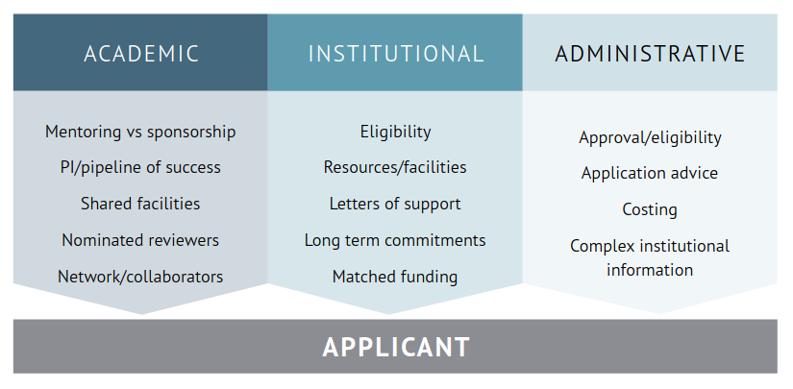
"We want the best people"
… reviewers are typically requested to assess applicants’ track records against subjective criteria such as “outstanding”, “excellent”, “high quality”, and their expectations for each level are likely to be associated with their own circumstances, and their judgements influenced by stereotypes they hold …
11 funding schemes in the UK were analyzed
Mentoring is becoming more available but sponsorship remains a scarce but vital resource
Letter of supports / pipeline of success has a dramatic impact on the application success
Assessing against irrelevant (?) characteristics e.g. confidence, self-promotion, persuasive, competitive ?
Quotas, targeted fellowships etc…?
Mentoring vs sponsorship
Provide targeted research funding guidance and support:
Notes:
Question: How do you evaluate people in your own group? When you are in committees?
Sponsorship: your PI selling your person or promoting your work
Pipeline success: how to write a proposal for this funding agency or go through you interview of
Substantial third party support is required to prepare and submit a successful research funding application, including support from other academics, from the host university, and from university administration; 2. Accessing support is dependent on individuals seeking it, and it is not offered equitably; 3. Support is often unavailable to researchers in marginalised groups, or is more challenging to secure; 4. Researchers in some groups can be perceived negatively for seeking support or advocating for themselves solely because of their protected characteristics; 5. Academic networks appear to be less available to marginalised researchers and seem to involve weaker relationships with less reciprocity; 6. Participants emphasised the added-value of sponsorship over mentoring, but also highlighted that sponsorship is less available to them;
Key deadlines being around school holidays

Slide 12
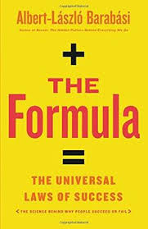
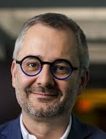

Networks networks and more networks!
1st Law: Performance drives success, but when performance can’t be measured, networks drive success.
2nd Law: Performance is bounded but success is unbounded.
3rd Law: Previous success * fitness = future success. (Matthew effect)
Notes:
Questions: getting people inside the 'networks' to access all these vital benefits - What is your opinions on accepting people from outside the standard networks you are very familiar with?
How can we reach people from outside the typical network - this can be generally interpreted as global people outside Uk/Europe/US, but also within these geographies, how to reach people from non similar backgrounds to us?
Visas/funding for national students exclusively?
Summary of the book: https://medium.com/@herbertlin7/a-summary-of-the-formula-the-universal-laws-of-success-6de0e3cd19e8
First law: tennis player vs scientis/artist Second law: you can publish x amount of papers as first/last author per month (assuming you work on those), the amount of prices/recognition/invitations is unlimited

Slide 13
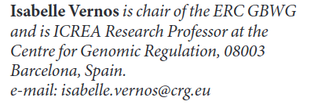
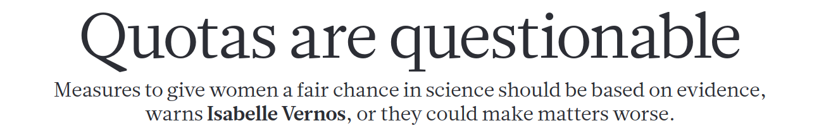
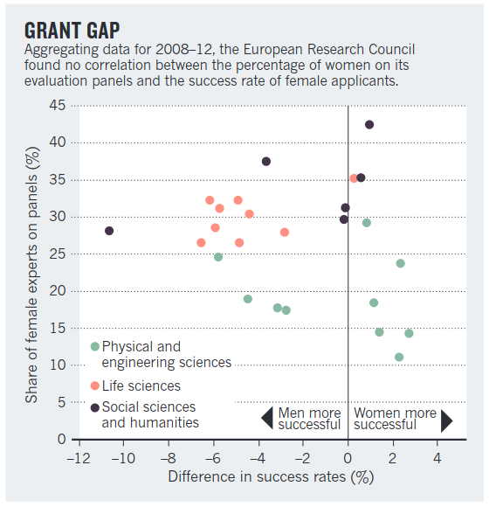
Are quotas a good idea?
So far, women make up a disheartening 19% of the ERC’s 3,500 grantees and account for just 25% of the nearly 35,000 applications received by the ERC to date;
Quotas in committees do not improve balance outcomes and create additional burden
Nature, vol. 495, page39 (2013)
Notes:
Quotas on pannels: --> they do not improve outcomes (female and male share the same biases) and on top they increase the burden

Slide 14
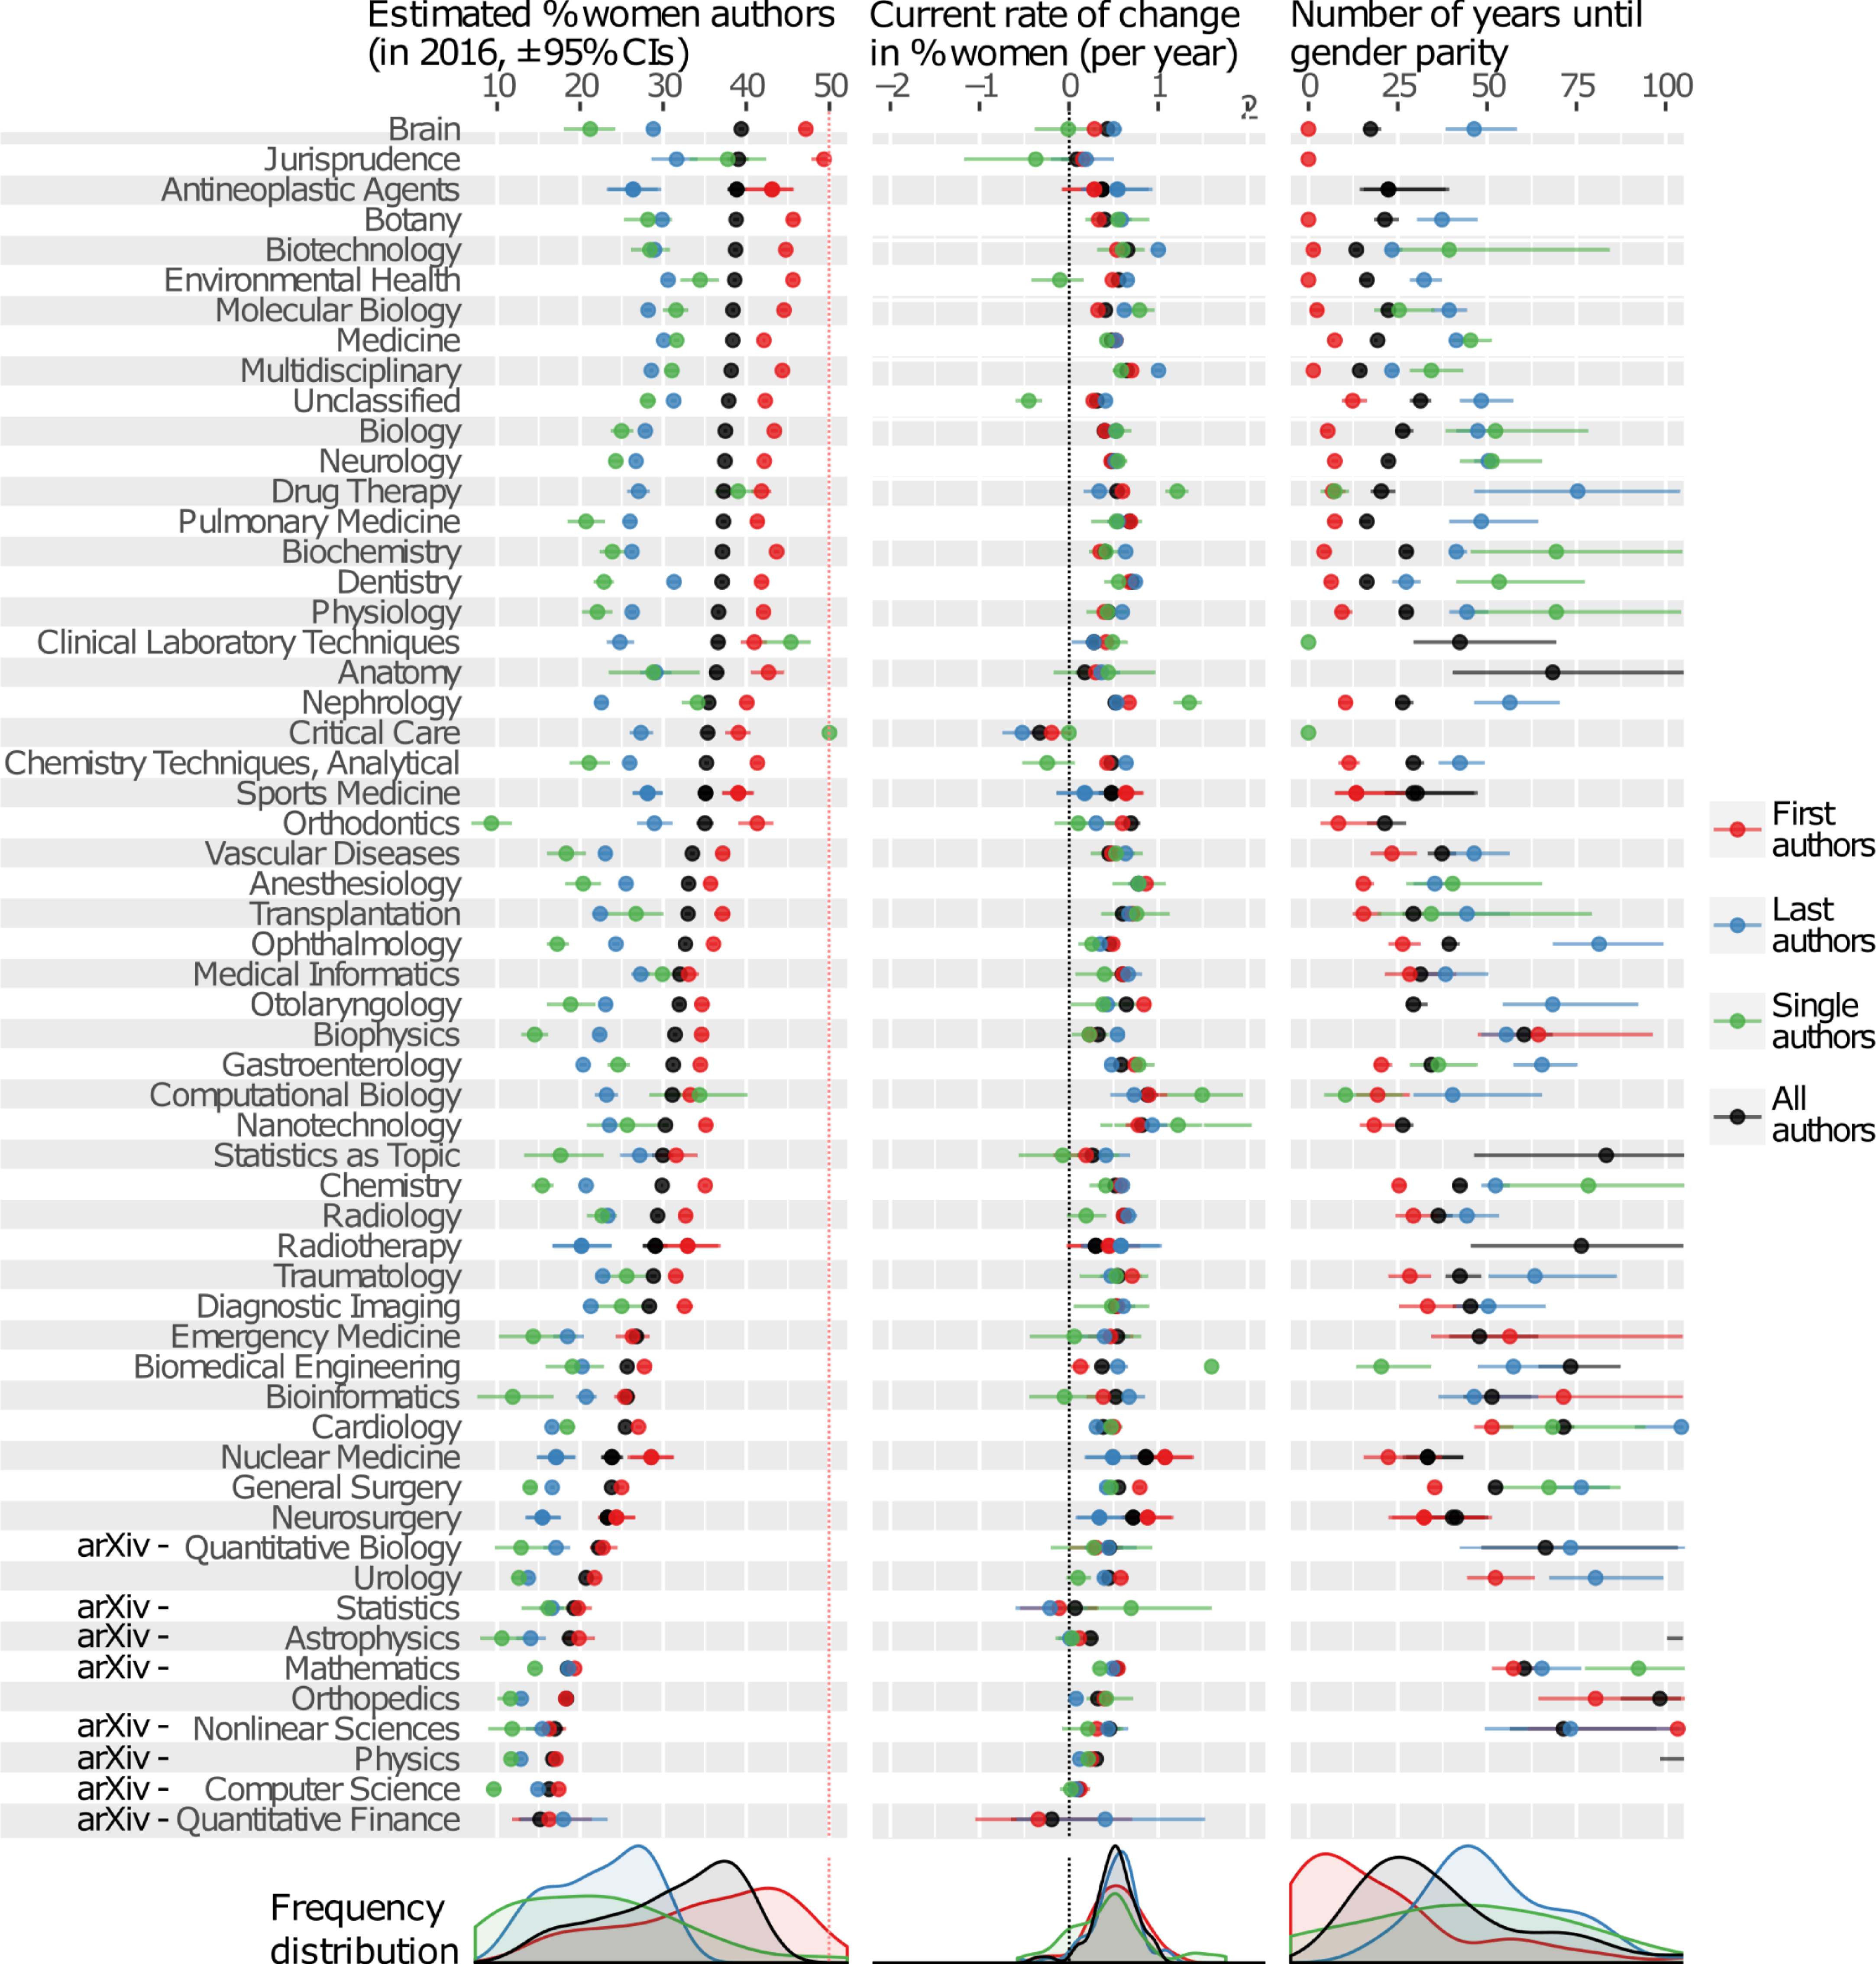
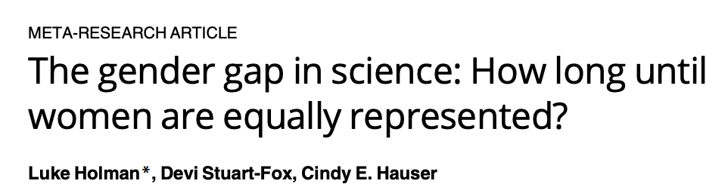
Are we on track to achieve equality?
Not exactly…
What is one piece of advice for future PIs?
Chemistry: 50-75 years
Physics: off the scale.. > 100 years
Citation: Holman L, Stuart-Fox D, Hauser CE (2018) PLoS Biol 16(4): e2004956
Notes:
Plot shows the predicted number of years until gender parity. For chemistry it is 50-75 years, so after all of our careers. For physics even more depressing, off the scale, so greater than 100 years.
The people in this room are mainly the future generations of Pis and scientists. If you had one practical piece of advice for the future PIs could themselves do to make an impact and improve the situation/ what should they keep in mind, what would it be?
If you also had one piece of advice for the women or otherwise margianalised people let's try to get 10 min of questions from the public!

Slide 15

Questions!

Slide 16
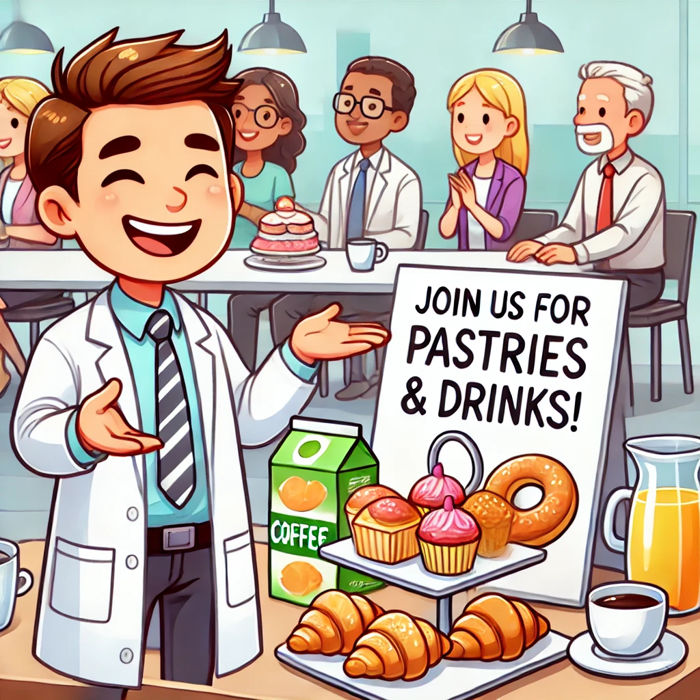
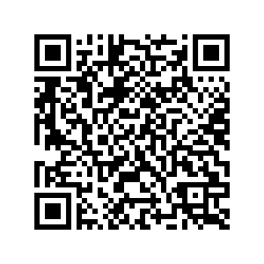
Thank you!
Panel members
Lisa
You
Join the LJC GEN slack workspace!

